Slide 1
HL7 FHIR & openEHR Interoperability & Intraoperability
Edited/polished version of the slides
Presented at the openEHR Developers’ workshop
31 Aug 2016 @ MIE/HEC2016 in Munich, Germany
By Erik Sundvall
Region Östergötland and Linköping University, Sweden

Slide 2
Interoperability vs Intraoperability
A model is agreed to that allows all systems to exchange what needs to be exchanged, without requiring any design changes to the way their systems works ☺
Whatever is done can be done on the periphery. And what can be done is therefore constrained to the lowest common denominator of the way that the systems function – all systems are constrained to the dumbest system ☹ (But it is a fast start for many simple use-cases ☺)
Smarter systems need to come up with their own (only partly standardized) “extensions” to the basic model so they can do smarter things. Many well known deficiencies of this (semantic scalability, fragmentation etc.) ☹
Examples: Messaging, HL7 FHIR etc.
Based on a post by Grahame Grieve (member of FHIR-core team) on February 28, 2012: http://www.healthintersections.com.au/?p=820
Notes:
ORDET Interoperabilitet används till för många väsensskilda skilda saker.
När vi kommer till INTRA… väldigt intressant för grupp som denna

Slide 3
Interoperability vs Intraoperability
Rework the core structures of the systems to function in an agreed way. Because all the systems work the same way, then exchange between the systems is easy and straight forward. ☺ (And internal model maintenance/update workload can be shared globally/nationally ☺.)
Intraoperability has fewer deficiencies, but they are much bigger: it’s much harder to get agreement… ☹ (Both technical and clinical agreements are needed to get maximum benefit of this approach ☹)
Examples: CIMI, openEHR, some usages of ISO13606 etc...
Typically, at this point, the system designers (often vendors) get the blame. But – it’s not as simple as that – vendors do whatever sells, which is whatever the purchaser wants to buy… Based on a post by Grahame Grieve (member of FHIR-core team) on February 28, 2012: http://www.healthintersections.com.au/?p=820 A more descriptive name for this kind of open intraoperability approach might be something like ”shared internal core structures” Note that the view of intraoperability described above is concerning vendor neutral models, there is another different (risky, lock-in-prone) definition of intraoperability focused around dominating market actors described at http://www.ecis.eu/intraoperability/)
Notes:
ORDET Interoperabilitet används till för många väsensskilda skilda saker.
När vi kommer till INTRA… väldigt intressant för grupp som denna

Slide 4
Exploring details of the interoperability-intraoperability continuum
App using native API
Message A
device
Native API
?
Native API
Clinical models
semantics & structure
Clinical models
semantics & structure
Other models
Export
Import
Message B
Other models
Export
Import
API X
?
API X
?
App using X
API Y
API Z
App
using Y
App using
X+Z
Usually not available to independent developers (trade secret)
Exceptions: open Source EHRs (VistA etc) or
openEHR based EHRs (both closed- and open source)
Native API connection (complete and semantically lossless)
Mapping (risk of semantic loss – see next slide)
Vendor controlled but ”openly” published API connection
Vendor neutral API connection (HL7 FHIR etc.)
Standardized message exchange (HL7 v2, CDA etc.)

Slide 5
Exploring details of the interoperability-intraoperability continuum
App using native API
Message A
device
Native API
?
Native API
Clinical models
semantics & structure
Clinical models
semantics & structure
Other models
Export
Import
Message B
Other models
Export
Import
API X
?
API X
?
App using X
API Y
API Z
App
using Y
App using
X+Z
Well known similar situation: App using vendor neutral API X with
vendor specific extensions of X
Usually not available to independent developers (trade secret)
Exceptions: open Source EHRs (VistA etc) or
openEHR based EHRs (both closed- and open source)
If truly* open: intRAoperability – of the ”good” open kind
*) truly = openly maintained, not controlled by specific vendor
Native API connection (complete and semantically lossless)
Mapping (risk of semantic loss – see following slide)
Vendor controlled but ”openly” published API connection
Vendor neutral API connection (HL7 FHIR etc.)
Standardized message exchange (HL7 v2, CDA etc.)
intRAoperability – of the risky lock-in-prone kind
Often focused around dominating market actors as
described at http://www.ecis.eu/intraoperability/
intERoperability

Slide 6
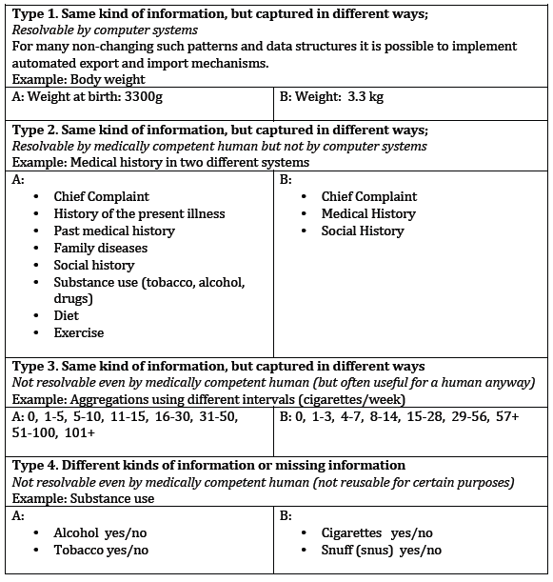
Let’s zoom in…
Native API
Clinical models
semantics & structure
Message A
Other models
Export
Import
Message B
API X
Message C
API Y
?
Mappings
The red lines represent manually maintained mappings between internal EHR model
and standardized API- or message-models.
Important but too often overlooked questions:
Are all use-case relevant mappings algorithmically
solvable (safely) or not? Creation+maintainance costs?
Source of table to the right:
Erik Sundvall’s PhD Thesis “Scalability and Semantic Sustainability in Electronic Health Record Systems” http://urn.kb.se/resolve?urn=urn:nbn:se:liu:diva-87702
Full text available online.

Slide 7
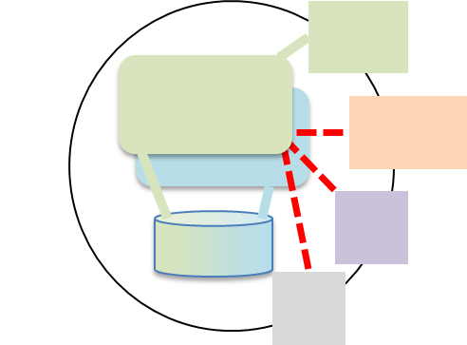
Interoperability vs Intraoperability Can you get inside the ”the walls of semantic difference” or just peek in and interact through vendor-selected API-holes and GUI?
Can you do a lossless move of entire healtth records between systems?
System XYZ
System XYZ
Where are you?
Where do you want to be?
What you want to do?
App delveloper?
Healthcare provider?
EHR system provider/vendor?
External infromation provider? (e.g. lab or pathology service)
EPIC
EPIC
EPIC
EPIC
System XYZ
EPIC
EPIC
EPIC
VistA
EPIC
EPIC
EPIC
VistA
EPIC
EtherCIS
Marand
Cambio
Cerner
Cerner
Critical Software
New openEHR-
based system?
Infinnity
Solutions
Cerner
Code24
EtherCIS
Cerner
DIPS
Cerner
DIPS
Cerner
Ocean Informatics
Noûsco
Cerner
Code24
Noûsco

Slide 8
When to use what? Inter- vs Intra-operability?
A continuum, not black/white. Some degree of both is often needed. What is your main pain?
Too much variation in input → focus on intra…
Too much variation in output → focus on inter…
Interoperability focused approaches e.g. HL7 FHIR, HL7 V2 messaging etc
Focus: exchange/messaging . ”Usual” way - mappings. Familiar to system providers etc.
Intraoperability focused approaches e.g. openEHR, HL7 CIMI (long term goal) Focus: sharing clinical documentation + sharing modeling workload
Easy to move entire health records (to other organizations or competing systems)
Approaches somwhere inbetween or all over the continuum: HL7 CIMI, ISO 13606 etc.
Notes:
This could be split into two slides to get less text per slide (e.g. right before ”How much can you influence decisions”

Slide 9
When to use what? Inter- vs Intra-operability?
How competent are you compared to your systems provider(s)?
We know more (and stay updated), and can specify it well → intra… But you’ll need to get involved in international (and national) collaboration.
Equal or varies a lot → ??? (very context dependent)
They know more → inter… Let them do internal modeling and tell you how to use it.
How much can you influence decisions (implementation/configuration) inside EHR systems?
Not much → interoperability! Intraoperability if of interest to system provider(s).
A lot → Might get intraoperability if you know what you are asking for, and why.
Notes:
This could be split into two slides to get less text per slide (e.g. right before ”How much can you influence decisions”

Slide 10
 | HL7 FHIR | openEHR
Main focus | Interoperability (find & use similarity?) Exchange and access ”FHIR is not written for clinicians, it's written for software developers” [2a] (and other implementation experts) | Intraoperability [1] (reduce differences inside?) Clinical documentation ”openEHR … working at the clinical semantics level with implementation as a downstream activity” [2b]
Clinical content selection | Common patterns implemented in existing systems. (Plus some other new needs that can be agreed widely upon.) ”The 80/20-principle”. [3] | Reqirements expressed by clinicians and implementing organisations via an international (sometimes national) online consensus process, open to all.
Technical focus | Easy/fast to understand and implement | Easy to maintain & extend EHR systems (new RESTful I/F make it easier to implement)
Local and speciality-specific adjustments | Extensions & Profiling Only non-extended FHIR resources guarantee easy international interoperability/similarity. (Extensions can be retrieved and analyzed. Data entered using previously unseen extensions follow the FHIR model and can thus be transferred and read by any system.) | Templates & Archetypes Only templates and archetype specializations based on international archetypes guarantee easy interoperability/similarity. (Local archetypes etc. can be retrieved and analyzed. Data entered using previously unseen archetypes follow the openEHR model and can thus be transferred and read by any system.)
Final decisions | HL7 member balloting | Clinical: mainly consensus in online review rounds – mostly clinicians Technical: Specifications Editorial Committee (SEC) – mostly EHR system implementers
[1] Open internal clinical models as in Grahame Grieve’s: Interoperability vs Intraoperability http://www.healthintersections.com.au/?p=820 (We do not mean intraoperability around a dominaitng vendor as in the definition at http://www.ecis.eu/intraoperability/) [2a] Lloyd McKenzie 2016 March 28 and [2b] Thomas Beale at March 29, both in https://chat.fhir.org/#narrow/stream/openehr
[3] Grahame Grieve, FHIR and confusion about the 80/20 rule, http://www.healthintersections.com.au/?p=1924

Slide 11
Options when using FHIR and openEHR
No alignment (just mapping)
To FHIR, openEHR can be seen just as any other EHR-system (and mappings can be done for some things)
To openEHR FHIR can be seen just as any other exchange format (and mappings can be done for some things)
Partial alignment (giving better mapping possiblilities)
Align the clinical content of some important resources and archetypes. Then keep each other updated regarding new versions. (Already done e.g. for Adverse Reaction)
Create shared and (inter)nationally maintained FHIR extensions/profiles to carry the extra datapoints from openEHR systems.
Encapsulate one in the other [Ian!]
Discussions between FHIR and openEHR developers (and inside HL7) regarding finding ways to carry openEHR-modelled data using new kinds of FHIR formalisms (enabling more automated transformations rather than manual mapping)
Facade FHIR-repositories (and legacy systems) as openEHR data-sources and use in openEHR query/retrieval/display (related to DIPS’s experiments, Norway)
HAPI (open Source FHIR wrapper)?
SMART on FHIR on openEHR (shown e.g. by FreshEHR, UK – using mappings etc.)
Join the discussion at https://chat.fhir.org/#narrow/stream/openehr/

Slide 12
The End
Questions?
Discussion!

Slide 13
Extra slides if needed

Slide 14
Interoperability vs Intraoperability Can you get inside the wall or just peek in and interact through API-holes and GUI? Where are you? Where do you want to be? (Depends on who you are and what you want to do)

Slide 15
msg

