Slide 1
Clinical Knowledge Governance
Dr. Sebastian Garde
Ocean Informatics
Medinfo 2013
Copenhagen, 19.08.2013

Slide 2
Why Clinical Knowledge Governance?
“Large e-health programs are often severely hampered by ill-defined user requirements, low levels of stakeholder engagement, slow solution adoption rates among providers, and an unwillingness to invest the often large amounts of capital required.“
Bartlett, Chris et al. Optimising E-Health Value: Using an Investment Model to Build a Foundation for Program Success. Perspective, Booz & Company 2010.

Slide 3
Why Clinical Knowledge Governance?
Instead of defining clinical concepts again and again, do it right once.
Comprehensive
High quality
Formal
Intuitive
International
Without:
Impossible to exchange and then use information in a semantically safe way – no matter how well done anything (e.g. DSS) that works with the information is.

Slide 4
Domain Knowledge Governance
…comprises all tasks related to
establishing or influencing formal and informal organizational mechanisms and structures
in order to
systematically influence the
building, dissemination, and maintaining of knowledge within and between domains.*
* Garde S, Heard S, Hovenga E. Archetypes in Electronic Health Records: Making the case and showing the path for domain knowledge governance. HIC 2005
Notes:
Firstly, there will be significant concept overlaps between the health care domains, and after all what domains do we need to differentiate for the archetype purpose in the first place? For example, it may be that a nursing archetype for an oral assessment for example is equally applicable to knowledge domains other than nursing? Or that various nursing fields have different needs? Essentially, domain experts need to be coordinated and ‘rank growth’ of archetypes avoided.
Secondly, some archetypes need to be standardised as they are relevant for and need to be semantically interoperable between the various health areas and specialist fields and also between various organisations. It has to be defined what these archetypes are and who is responsible for them.
Thirdly, archetypes need to be easily accessible (e.g. on an internet server) and easily locatable, i.e. organised in a way that a certain archetype can be retrieved with high recall and precision from all archetypes.
Fourthly, archetypes have to be evidence-based. Knowledge in archetypes needs to be based on evidence or best practice although it can include ‘tacit’ knowledge acquired by experts and agreed to by consensus.
Fifthly, archetypes need to be maintained and systematically updated when knowledge changes.
Sixthly, while the Archetype Editor is quite intuitive, domain experts must have a basic understanding of archetypes and openEHR’s logical building blocks of an EHR (folders, compositions, sections, entries, clusters, elements, and data values) to build useful archetypes, adequate training has to be provided.
Finally, and more theoretically, it is argued by [Kumar et al. 2004] and [Pisanelli and Gangemi 2004] that the adoption of an ontological framework facilitates the building of better and more interoperable information systems. It facilitates unambiguous communication of complex and detailed concepts. A domain ontology catalogues various aspects known to exist within the domain of interest from a specific point of view to suit a defined purpose. An ontological domain knowledge model shows how key concepts relate to one another and is usually based on a philosophical or theoretical foundation. The term ‘ontology’ in the field of health concept representation describes the representation of concepts and the reality they attempt to describe. For example terminologies, classifications, knowledge bases, nomenclatures etc are all examples of attempts to represent an ontology [Standards Australia 2004].

Slide 5
Input
Proposals
Change Requests
Accompanying documentation
Reviews/Feedback
Clinical Knowledge Governance
Initial clinical models
Develop models
Output
Published Clinical Models (Archetypes, Templates, Termsets)
Release Sets
Accompanying documentation
Review summaries etc. for accountability & transparency
Review models and organise editorial feedback
Discuss models
Revise models
Validate models
Version / Revision management
Lifecycle management
Reuse of models developed elsewhere
Dependency management

Slide 6
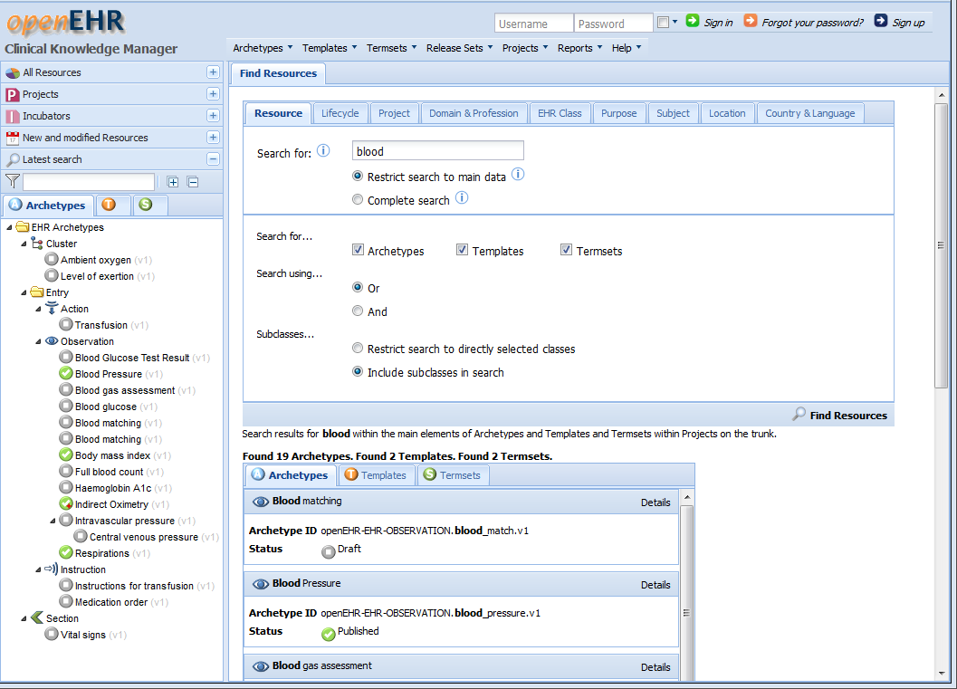
Clinical Knowledge Manager
A web application for involving clinicians in defining clinical content based on archetypes, templates, and termsets

Slide 7
CKM Approach
Web 2.0 approach
Easier to engage clinicians: Can now use 5 mins or 1 hour of an expensive specialised clinician's time; before, they lost hours on physical meetings!
Implementation is growing as we learn
Can respond quickly to changing needs, evolving methodology
More than a tool
Engage and manage the community

Slide 8
CKM Core Principles
„Right“ separation of technical and clinical aspects to
Involve clinicians in
Informal Discussions
Formal Reviews (content, terminology binding, translations)
Sharing
Enable
Formal expression of content
Publishing
Revision/Version Management
Release and Dependency Management

Slide 9
Standardising Archetypes
Empowerment of Domain Experts
Increase Benefit
Record once, use multiple times
Aggregation of Data (Reports)
(Semantic) Querying
Semantic Interoperability
Basis for lifelong EHRs
Basis for (usable) Decision Support (which depends on having the relevant data accessible and queryable in the first place!)

Slide 10
Demo

Slide 11
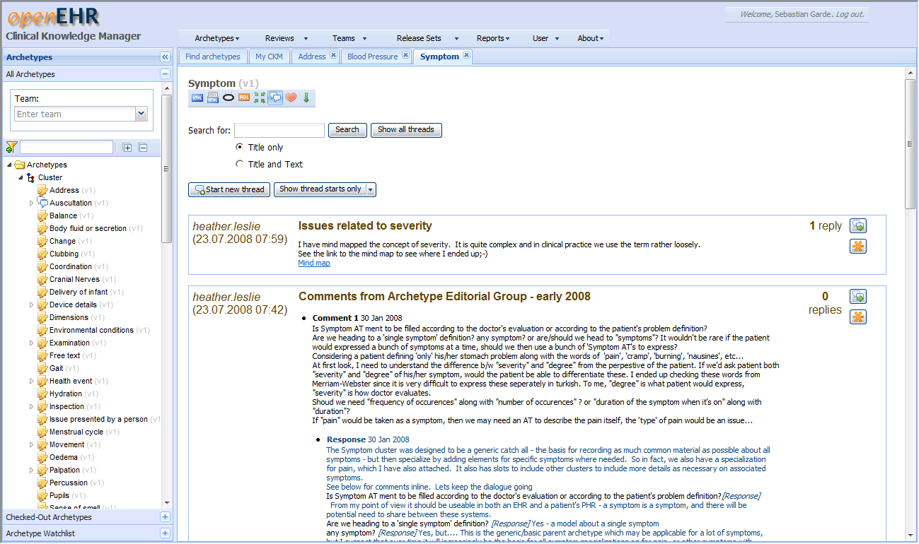
Discussions

Slide 12
Archetype Reviews

Slide 13
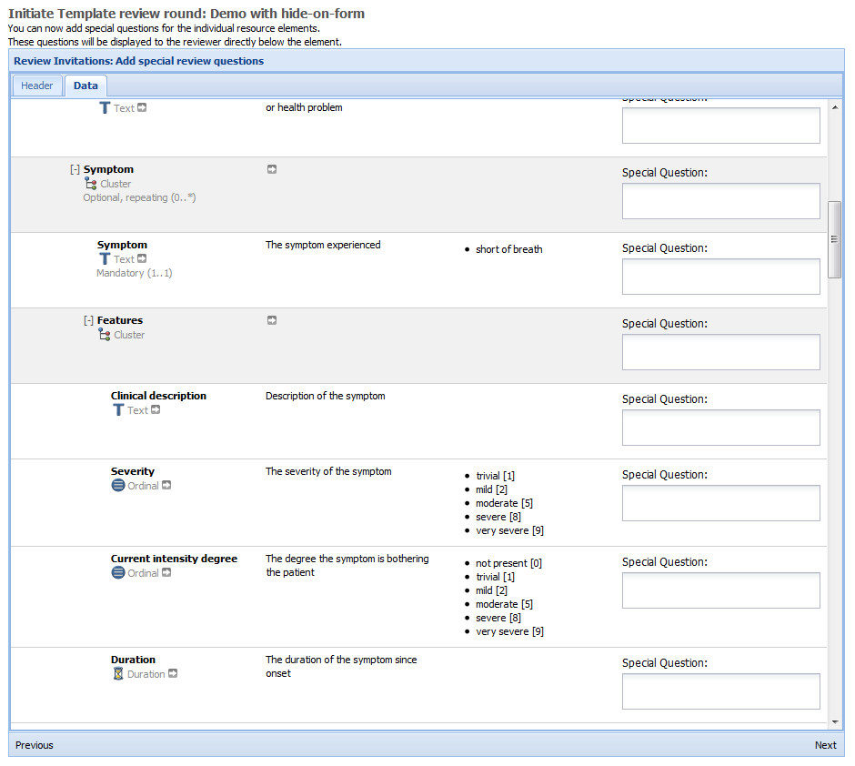
Template Reviews
New

Slide 14
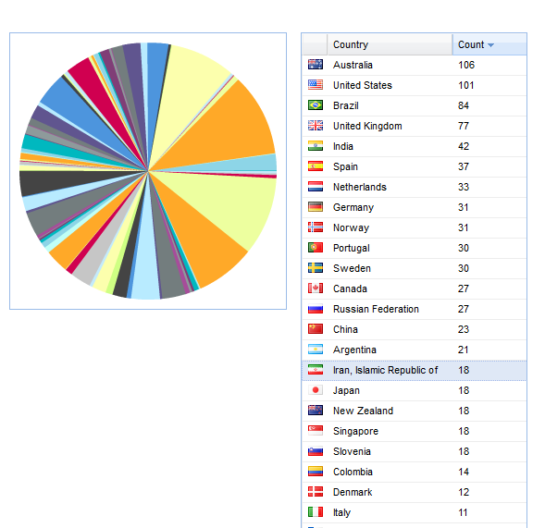
CKM Users
Countries
International openEHR CKM instance
> 1000 users
From 80 countries
From all Health professions and many health domains
Also National programs with an instance of CKM

Slide 15
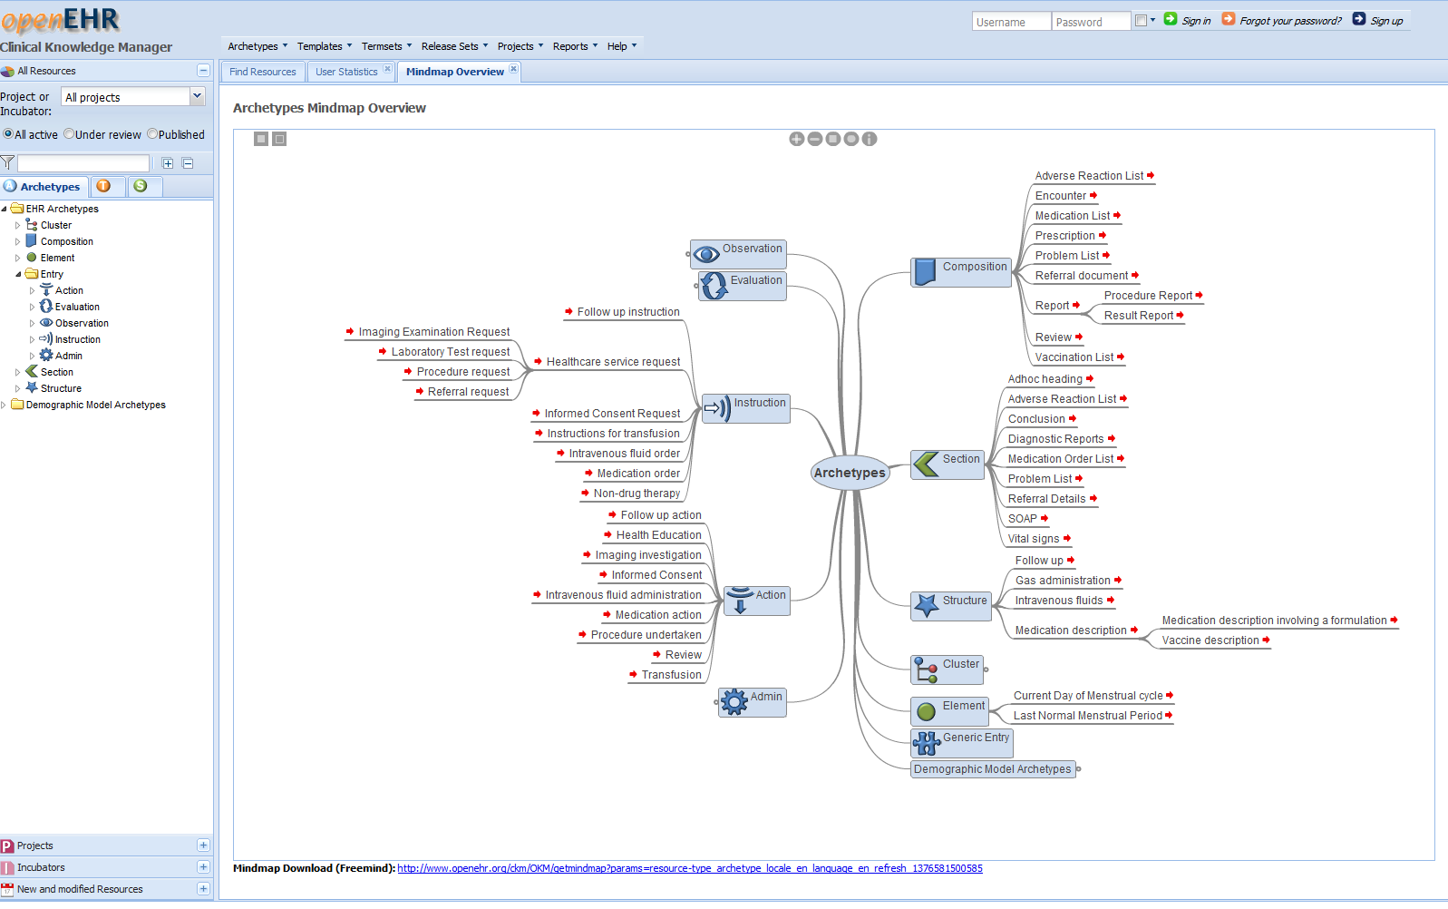
Use the Same Archetypes in Various Applications, Worldwide
...

Slide 16
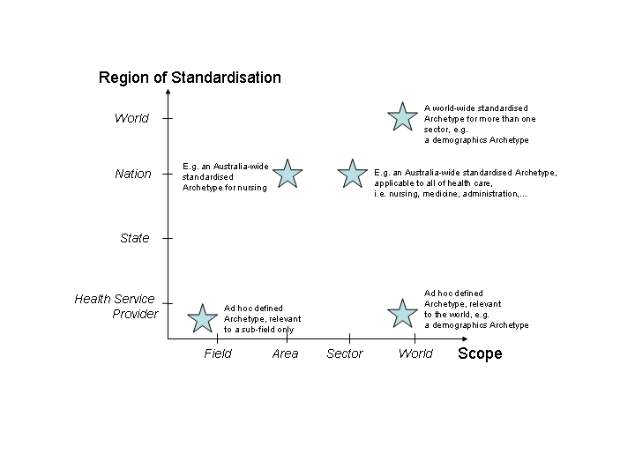
Designing Archetypes Beyond Your Realm of Influence
ISO
openEHR foundation
It’s international… ...but needs to be supported by national organisations
SA,
DIN, ...
SKL,
NHS,
NeHTA,
AIHW,
DIMDI,
…
Medical Colleges,
NNO
Local Provider A
Local Provider B
Local Provider C

Slide 17
Federation of CKM Instances
Imported from Remote CKM
Cached in local CKM
Reference to original location and publication status
Unchangable in local CKM
Updated from remote on demand
Clinical Knowledge Manager

Slide 18
Beta
... (+Updatable Archetypes)
...

Slide 19
Challenges & Next Steps
Federation of CKM instances
GDL support (guidelines)
Reference Model Independence
Flexible Reference Model View, not constrained items only
E.g. ACTION.time: Point in time at which this action completed.
Long way down a very long road

Slide 20
Key Messages
Knowledge Governance is crucial
High-quality archetypes with high-quality clinical content
Semantically interchangeable between clinical systems; also the basis for decision support
Key to success: how to engage with clinicians and capture their knowledge
CKM is the tool for it
Regionally, nationally & internationally
Register at http://www.openehr.org/ckm

Slide 22
Designing Archetypes: Region and Scope
Notes:
When designing archetypes you have to be aware…

Slide 23
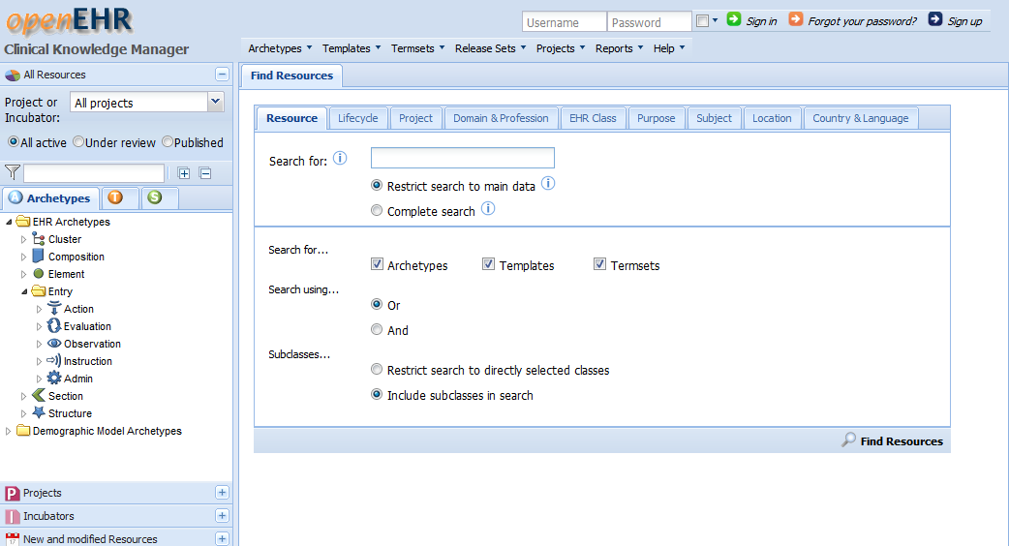
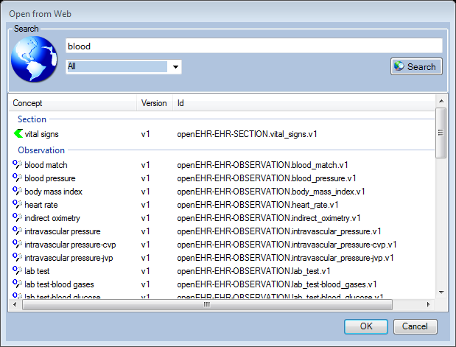
CKM Design Overview
Asset
Management
System
Middle Tier
Apache
Tomcat
Google
Web
Toolkit
Java
Servlets and
Webservices
CKM plugins
GWT RPC
Core Asset
Services
Webservices
XML Database
File Stores
GWT, Javascript,
XSLT

