Slide 1
Overview Introduction of
Guideline Definition
Language (GDL)
Rong Chen MD, PhD
CMIO, Cambio
Medinfo 2013, Copenhagen
2013.8.19

Slide 2
Outline
Background introduction
Scope and design of GDL
A quick GDL demo
Summary, Q&A

Slide 3
Cambio Healthcare Systems
Founded in 1993
– 330 staff across the globe
– Private and Venture funded
The leading provider of Regional EHR solutions in Scandinavia - presence in Sweden, Denmark, UK, others to follow
COSMIC is an international standard product
Close to 95 000 staff users when current projects are fully implemented
Our solutions are open, scalable and flexible based on industry standards
Cambio invests 150 000 hours annually in COSMIC
ISO 9001 certification and CE Marked EHR
Notes:
TMM

Slide 4
Alerts
Quality
Registries
Clinical
Decision
Support
Clinical
Trials
Order sets
Compliance
Checking
Knowledge
Management
Computerized
Guidelines

Slide 5
Scope & Aims
A formal language to express CDS rules
Natural language independent
Easy to add translations
Terminology independent
Easy to add term bindings
EHR model independent
Reuse of common EHR models both for input and output
Rules for single decision making
Process handling not in scope
Coherent and reusable
Encapsulated and possible to chain the rules
Technical platform independent

Slide 6
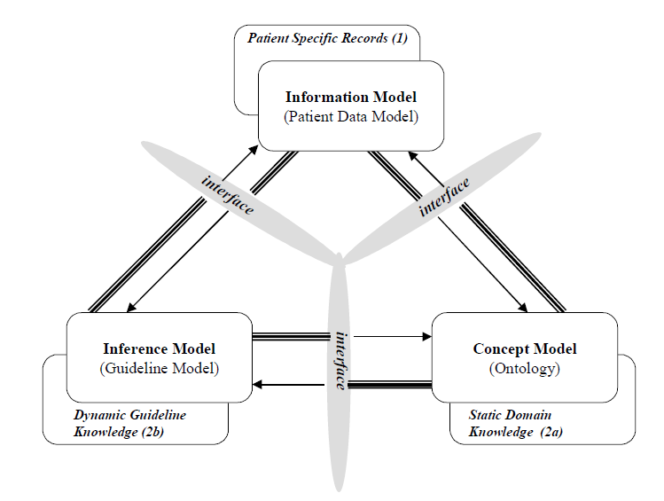
openEHR Archetype
???
SNOMED CT
A L Rector PD Johnson S Tu C Wroe and J Rogers (2001) Interface of inference models with concept and
medical record models. in S Quaglini, P Barahona and S Andreassen (eds) Proc Artificial Intelligence in
Medicine Europe (AIME-2001 ) Springer:314-323

Slide 7
Guide Definition Language (GDL) Design
A minimum language to glue together
archetypes, terminologies and rules
Three Pillars
Bindings between archetype elements and variables in the rules
Rule expressions easily converted to industry rule engine languages
Bindings between local concepts used in the rules and concepts from reference terminologies

Slide 8
1st Pillar: Bindings between archetype elements and rule variables
Each rule variable is unique identified by a gt code and mapped to a Archetype ID and a path to access an element
The same gt code is used to represent the variable in all rules in the same guide
Then the gt code is translated into terms in different natural languages (English, Swedish..)

Slide 9
2nd Pillar: Rule expressions easily converted to industry rule engine languages
when & then statements are commonly supported by rule languages
Expressions used in these statements are based on common design (similar to assertions in openEHR Archetype Definition Language)

Slide 10
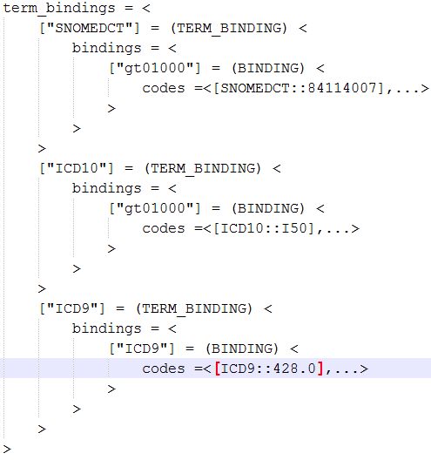
3rd Pillar: Bindings between local term used in the rules and concepts from reference terminologies
a local term is used as a proxy to externally defined concepts in reference terminologies
a local term can be bound to list of concepts or a refset in different target reference terminologies

Slide 11
Guide Definition Language (GDL) Design Cont.
A formal language based on openEHR d-ADL
Machine-readable format
The main object model consists of
Header: Id, concept, language, description, translation
Archetype binding
Guide definition, pre-condition and list of rules
Each rule has when and then expressions
Term_definitions for language-dependent labels
Term_bindings for terminology bindings
Expressions model
Extensive reuse of existing openEHR specifications

Slide 12
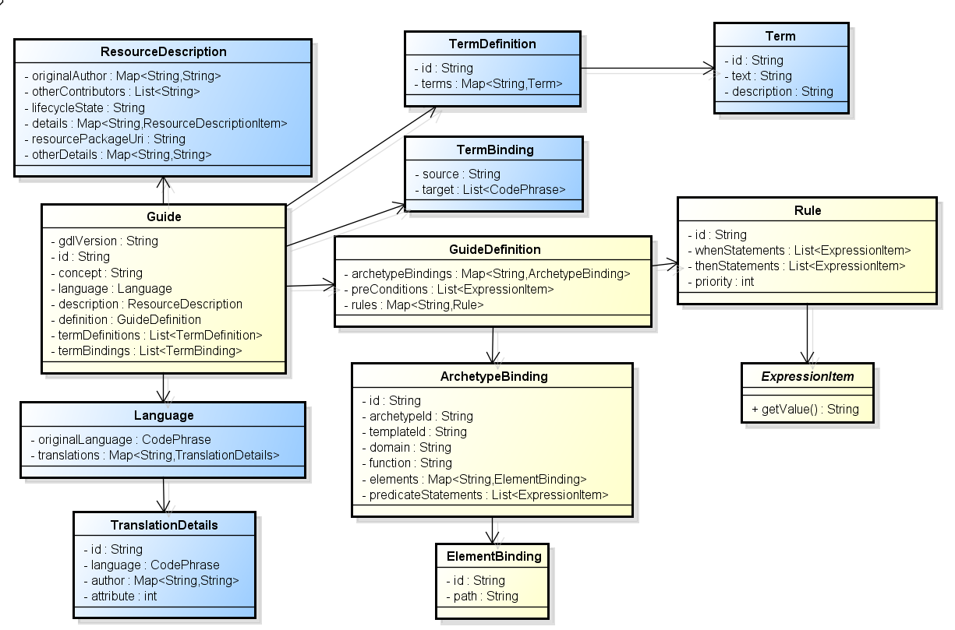
GDL Model
Blue: openEHR
Yellow: new

Slide 13
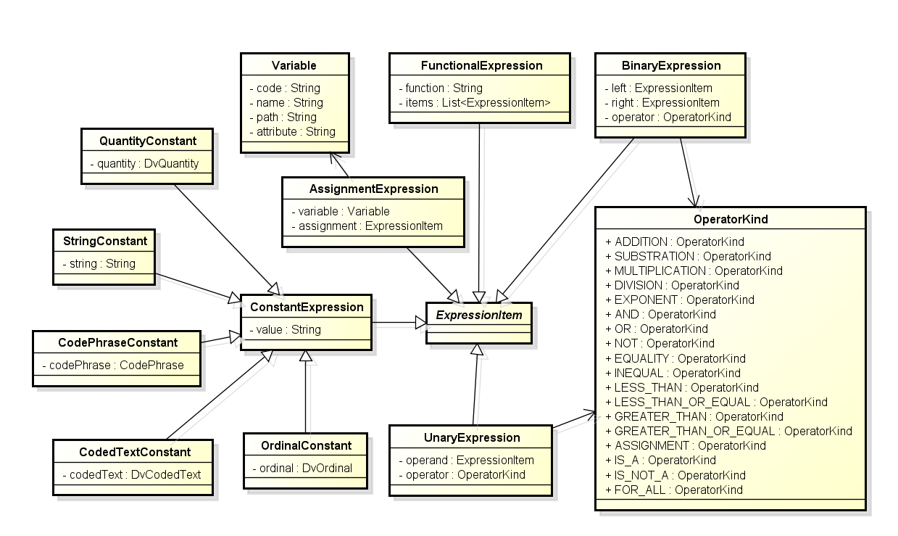
GDL - expressions

Slide 14
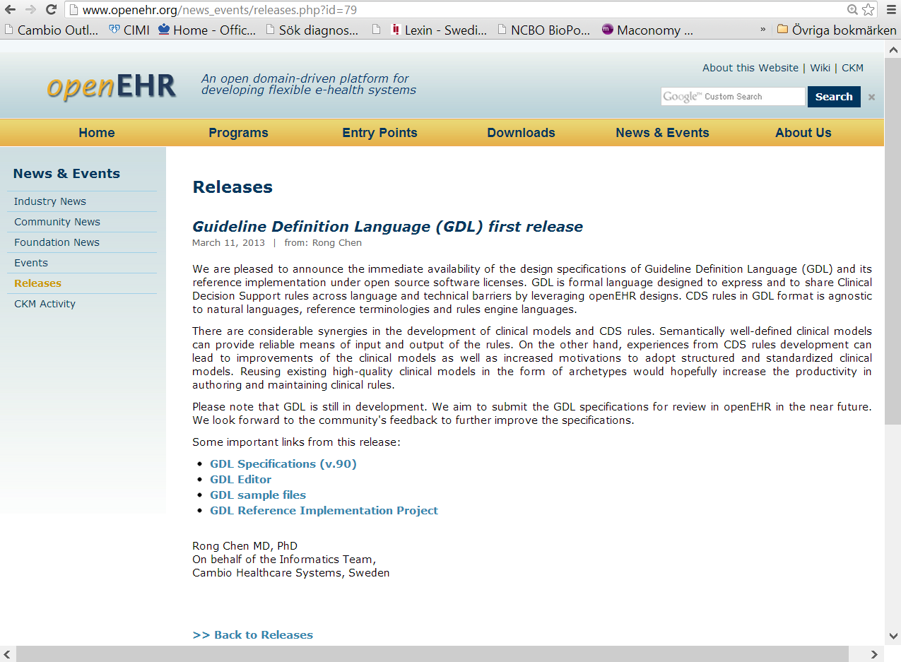
Publicly available specifications
Open source reference implementation

Slide 15
GDL Specifications
http://openehr.org/downloads/ds_and_guidelines

Slide 16
GDL Live Demo
CH2DS2-VASc Score Calculation

Slide 17
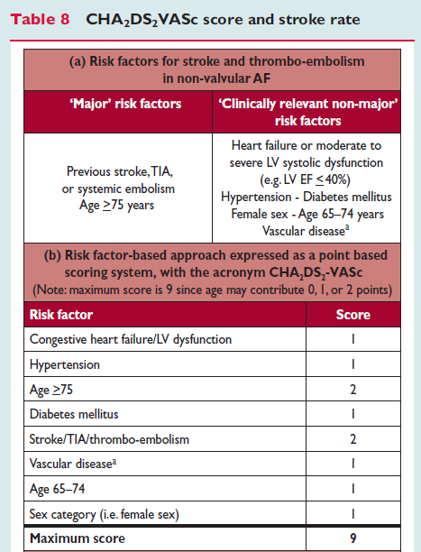
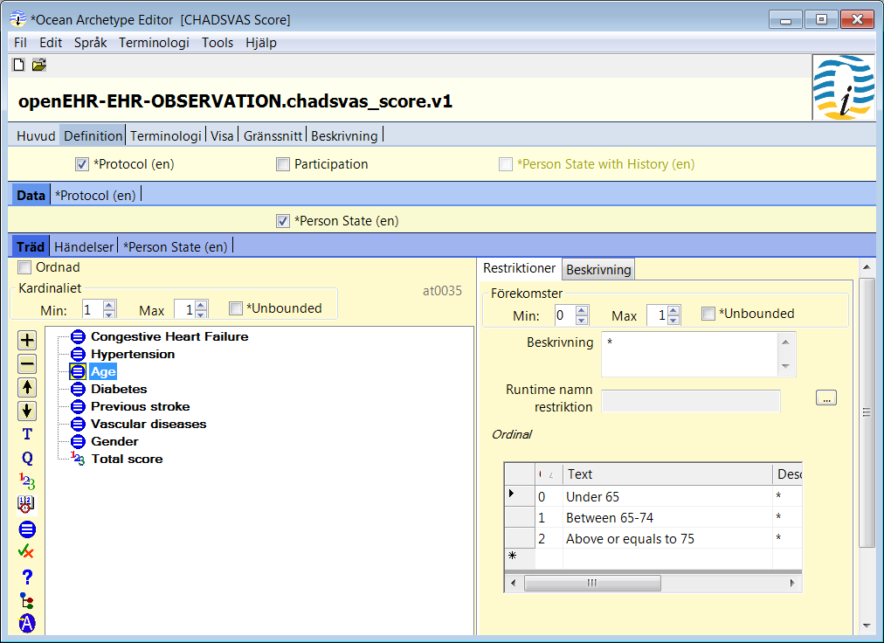
CHA₂DS₂-VASc Score Archetype

Slide 18
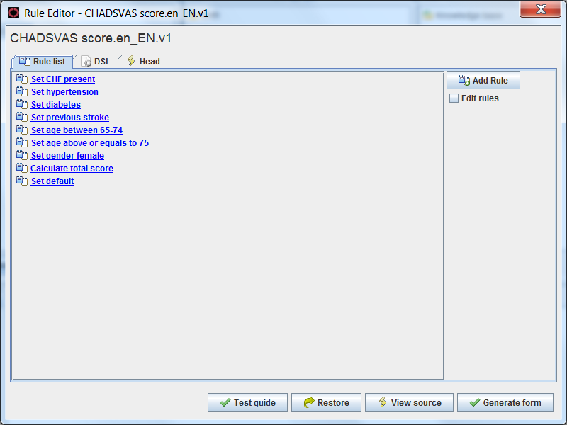
GDL Guide for calculating CHA₂DS₂-VASc score
EHR queries + reasoning
Direct EHR queries
The CHA₂DS₂-VASc score archetype servers both as intermediate results place holder and final output from CDS

Slide 19
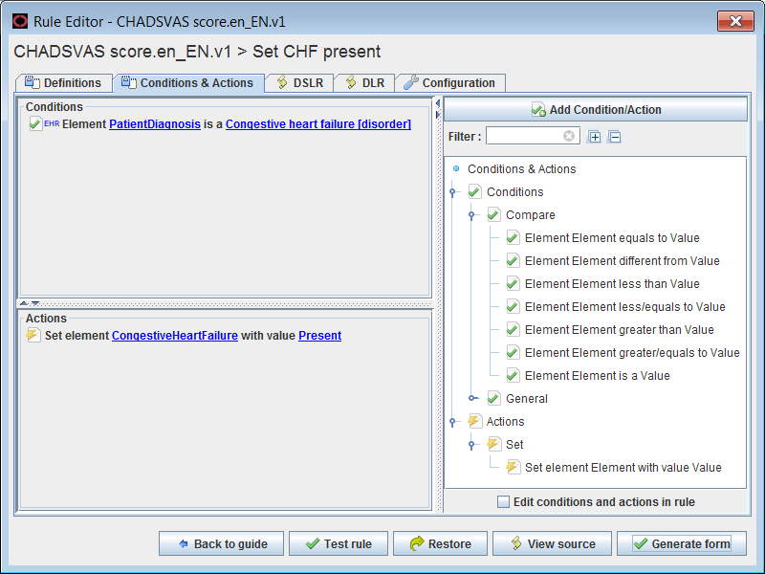
Rule for Checking Congestive Heart Failure
If patient has any diagnosis that is kind of congestive heart failure?
If so, set the congestive heart failure sub-component to ‘present (1) ’.

Slide 20
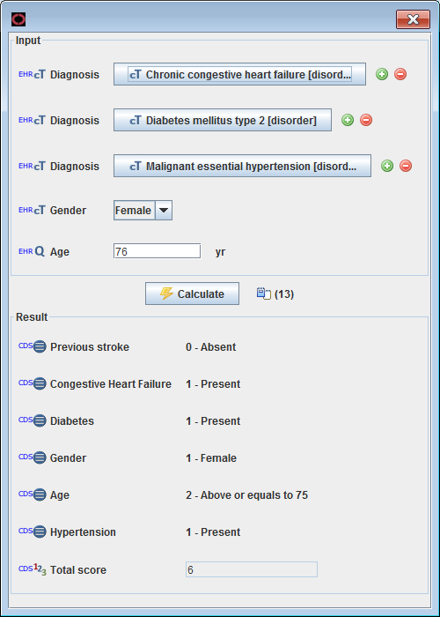
Simulation of CHA₂DS₂-VASc Guide

Slide 21
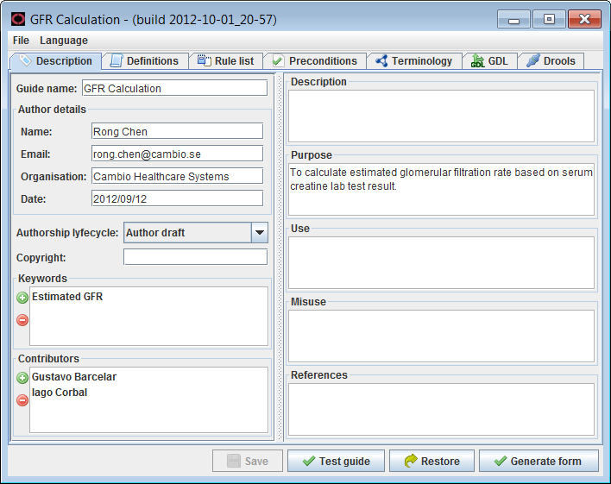
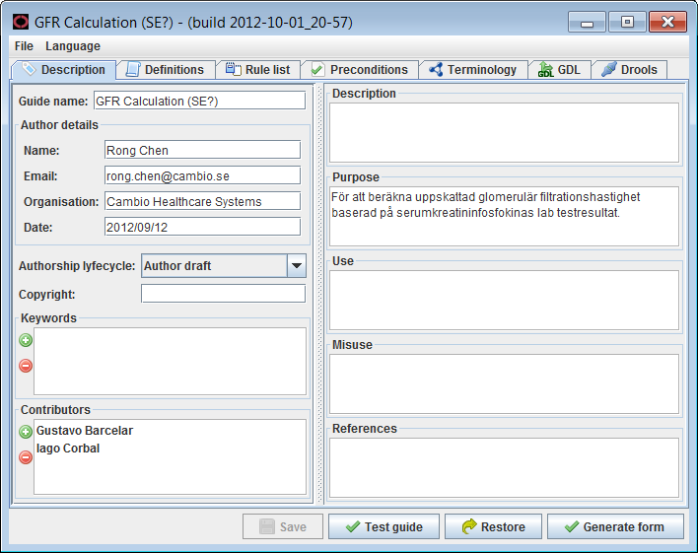
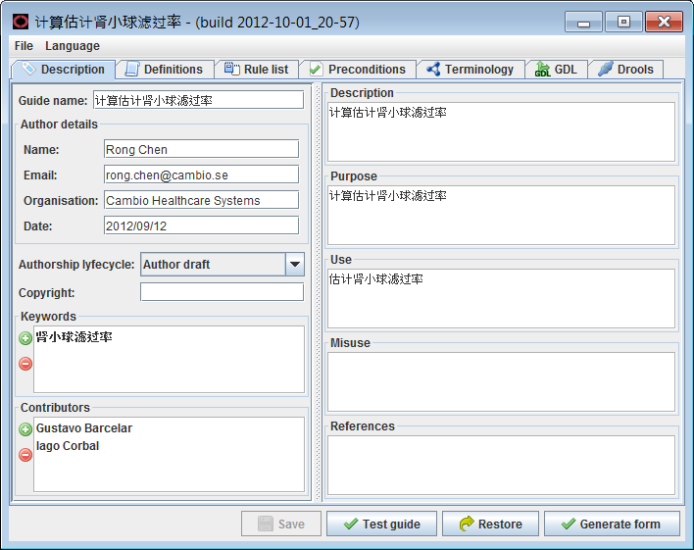
Support for Natural Languages - Header
Swedish
English
Chinese

Slide 22
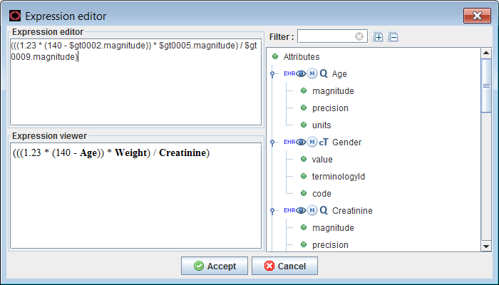
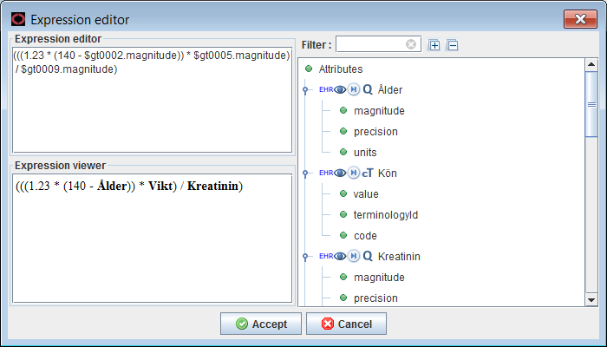
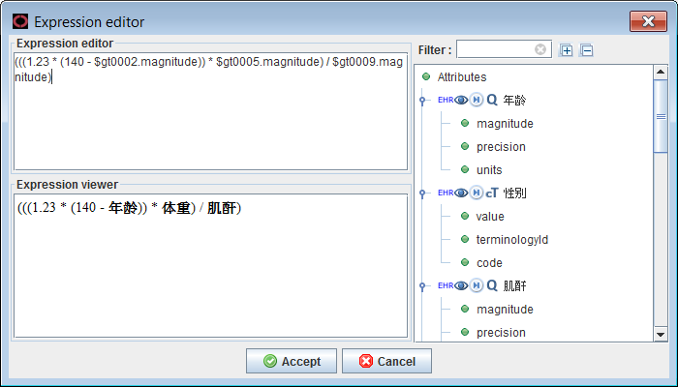
Support for Natural Languages - Expressions
English
unchanged
Swedish
Chinese

Slide 23
Summary
GDL is a formal language for expressing single decision-making rules and is agnostic to natural languages, reference terminologies and technical platforms.
GDL is released as publicly available specifications and backed by a open source reference implementation.
Questions / comments ?
Rong.Chen@cambio.se

