Slide 1
openEHR Terminology binding
Thomas Beale

Slide 2
Problem overview

Slide 3
What is ‘terminology binding’?
A formally expressible connection between information model representation and terminology representation of clinical statements recorded in the EHR

Slide 4
What is the ‘binding problem’?
We need to know how to control the use of terminology within structured data so that it achieves what we want:
Provides basis for querying
Economically feasible
First, we need to know how to structure data so it:
Doesn’t violate ontological truths;
Is mappable to ontological concepts;
Supports data entry, storage, querying, reuse

Slide 5
Which ‘structured’ data?
Two kinds:
Legacy proprietary: structures are all different
Shared, standardised: agreed structures and information model, within a community of users (can be more than one such community).
The second kind we can standardise on.
Shared clinical data generally include structure and many data types.

Slide 6
Data are structured
Clinical statements are naturally structured, e.g.
lab results: list / tree structure; normal ranges;
Microbiology is usually a large tree structure
vital signs: timing and multiple data points;
BP: (2 data points + patient state) x time-series
physical examination: structured by anatomy
E.g. Endoscopy of colon
assessments: structured according to e.g. temporal model of disease course;
orders: timing info, structured medication info;
actions: timing, medication structured info

Slide 7
Other sources of structure
Data capture: at the user interface, the elements of a clinical statement are naturally distinct, e.g. procedure, site, protocol, time...
Document structures: reports, referrals etc are also structured, including audit info, sections.
For querying: data items that are queried for separately are usually separated, e.g. procedure type and body site.

Slide 8
Data have many types
Clinical statement data includes instances of:
Text
Coded terms
Quantity, including units, proportions, counts, etc
URIs
Booleans
Date, time, date/time, duration
Parseable text, e.g. Units, medication timing
Other more complex types

Slide 9
What should be SNOMED-coded?
Answers which are:
textually expressible
whose value range is
Best modelled by as ontological description (i.e. discrete categorisation),
likely to be independently queried later on.
E.g. types of disease; blood types; but not general patient story (not expressible as just concepts)
I.e. a subset of textual data, which are a subset of all data

Slide 10
What could be SNOMED-coded?
Questions which:
Need to be queried on using an agreed reference coding standard.
Example: ‘serum sodium’ (in context of blood film result of patient) does not need any coding to be 100% reliably queryable in openEHR environment. However, for the data to be re-usable by ANYONE later on, SNOMED-coding makes sense.

Slide 11
Understanding the binding problem
One thing complicates the task...SITUATION
Examples:
list of body positions is not the same as list of body positions pertinent to measuring BP;
valid Rh blood types differs depending on whether for blood collection or transfusion;
almost all scales, e.g. Apgar, GCS, Borg, Barthel etc define their own value sets for common phenomena, which differ from contextless value sets of the same / similar phenomena in naming and number of divisions.

Slide 12
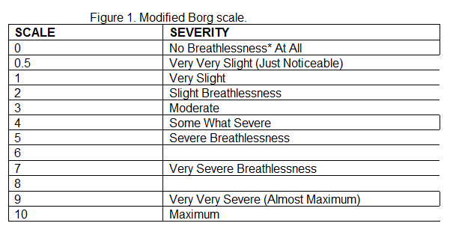
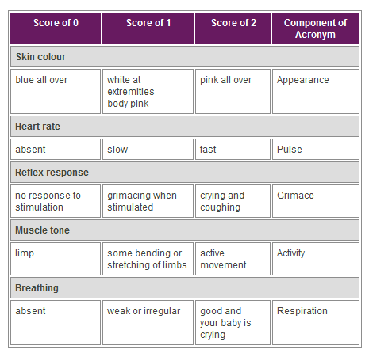
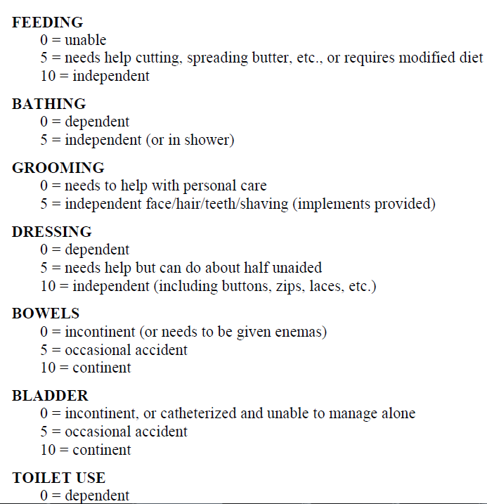
Value sets in scales

Slide 13
Binding and openEHR

Slide 14
Where is binding relevant in openEHR?
openEHR Archetypes - essentially, maximum data sets, i.e. all data points for a given domain ‘recording’ concept (not its ontological ‘description’).
Examples:
Vitals signs: BP, Heart-rate etc
Labs – very structured, well understood
Physical exam – e.g. Pain, symptom....numerous!
Scales, e.g. GCS, Apgar, Barthel – ordinal data
Terminology need: globally invariant mappings; broad value sets e.g. ‘infectious agent’

Slide 15
Where is binding needed?
openEHR Templates - essentially, use-case specific content specifications; consist of data points from archetypes
Examples:
Discharge summary
Lab report
Encounter note
Terminology need: define local / region-specific or specialty-specific value sets and constraints, e.g. ‘lung infection’
NOT JUST TO SNOMED CT!

Slide 16
Kinds of binding - today
Compositional expressions already used
Direct binding to concept points
Archetype local value sets → direct binding – value set specific to archetype
Ref set binding for data points that correspond to reusable value sets
Templates can have direct binding to SCT terms, with static value set defined in archetype or ref set reference

Slide 17
Kinds of binding - future
Context-dependent bindings
SCT Compositional constraints
SCT Composition pattern mapping?

Slide 18
Type 1 binding – direct

Slide 19
Direct binding
WHEN: we want to associate a terminology concept with a data item that we want to be able to query
Ex: systolic BP
Generally an archetype path → code binding
Each path acts like a post-coordination
E.g. 24 hour average systolic pressure

Slide 20
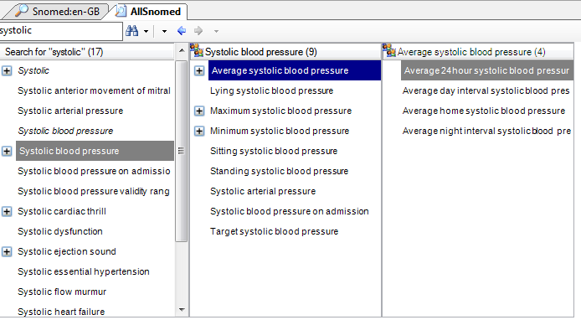
Which SCT concept do we pick?
If we bind |systolic blood pressure| (usually means instantaneous),
SNOMED-driven queries would pick up 24h av, max, min etc

Slide 21
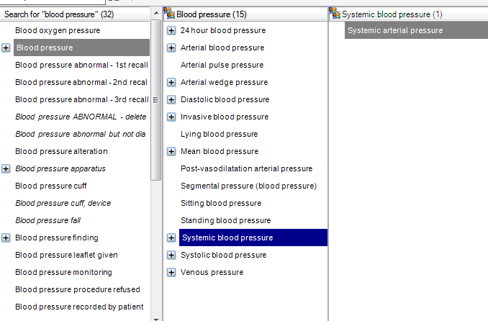
can ‘systolic’ be post-coordinated?

Slide 22
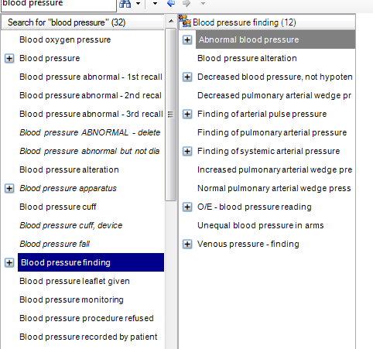
|Bp| v |bp finding|

Slide 23
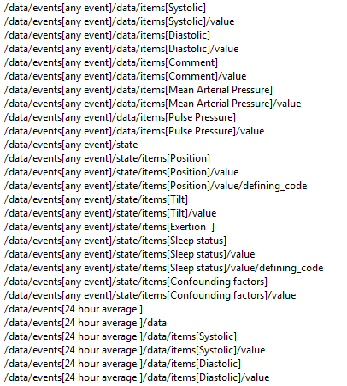
271649006 |systolic blood pressure|
OR
72313002|systolic arterial pressure|
OR
399304008|Systolic blood pressure
on admission|
OR....
314449000| Average 24hour systolic blood pressure|
Archetype paths

Slide 24
Considerations
Many parts of SNOMED, excessive precoordination makes it difficult to know what to choose
Basic problem: whatever binding modeller chooses, query author might choose a different concept, and the results may not be correct.

Slide 25
Type 2 binding – Compositional expressions

Slide 26
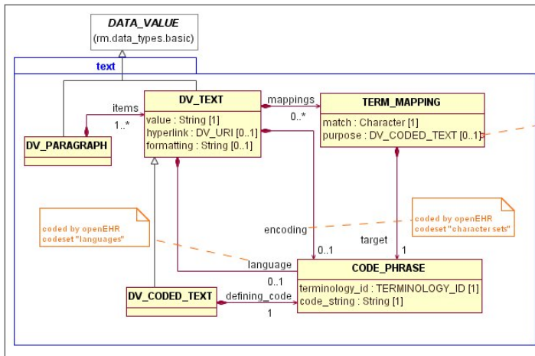
openEHR supports expressions
260686004=129304002,363704007=66754008}
=procedure:{method = excision – action, procedure site = appendix structure}

Slide 27
Considerations
What if information system uses pre-coordinated term? A different post-coordination? Will querying work?
Relies heavily on normal form & equivalence working correctly.... and being economic to implement!

Slide 28
Type 3 binding – archetype internal value set

Slide 29
Internal value set
WHEN: situationally dependent values,
e.g. Position of patient for blood pressure measurement
E.g. Set of breathing values for Apgar
WHEN: poor/no matches available in SCT
OR: good matches available, but no refset/subset available or desired, e.g. local use only
Currently VERY COMMON in archetypes, including for scales

Slide 30
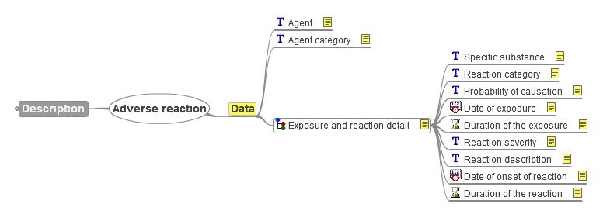
Adverse reaction (mindmap view)

Slide 31
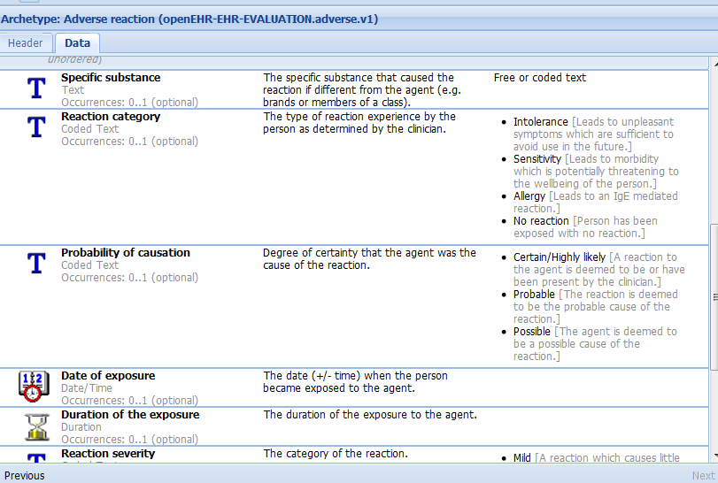
Attribute view

Slide 32
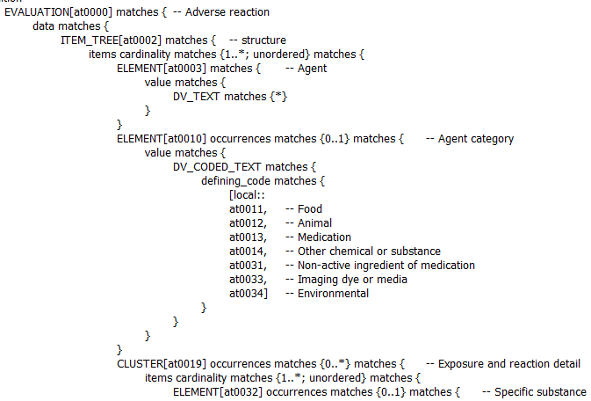
ADL view

Slide 33
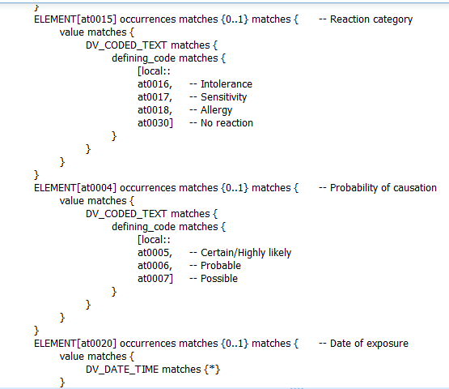

Slide 34
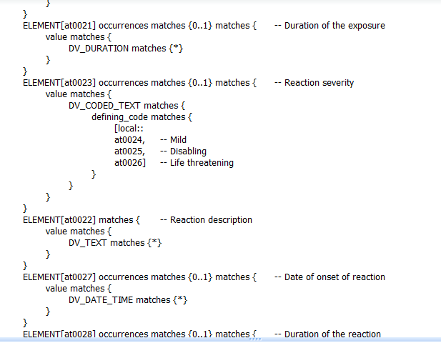

Slide 35
Agent category binding...
Archetype term | SCT candidates
at0011|food| | 406465008|food allergen|, 255620007|Foods| Note 149 top-level concepts containing ‘food’
at0012|animal| | 39866004|animal| Note 241 top-level concepts containing ‘animal’; no ‘animal allergen’
at0013|medication| | 119 top-level terms containing ‘medication’ (heavily pre-coordinated), but no |medication|...!
at0014|Other chemical or substance| | 33565001|chemical agent| ??? 167 top-level concepts containing ‘chemical’
at0031|Non-active ingredient of medication| | Nothing with ‘ingredient’
at0032|imaging dye or media| | Nothing suitable
at0033|environmental| | Some approximate matches...

Slide 36
Considerations
Should we bind to SNOMED at all?
Codes could be useful, since we might want to find adverse reactions caused by ‘environment’ or ‘food’
How to bind, or model?
Currently, the archetype defines the value set
Could bind each internal code to an SCT code
Difficulties finding candidate concepts
Could we use a ref set instead?
This archetype has 4 internal coded value sets...what happens with 2000 archetypes?

Slide 37
Type 4 binding – ref set

Slide 38
Ref set binding
This is for data points that correspond to context-independent domain concepts, e.g.
Pain character
Infectious agent
The archetype or template can include an ac-code that binds to an external resource, such as a ref-set id/URI.

Slide 39
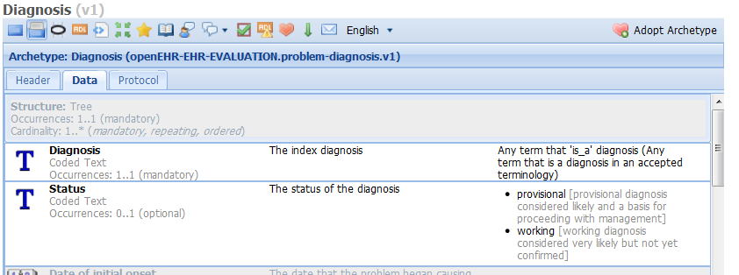
Problem/diagnosis

Slide 40
constraint_bindings = <
[“SNOMEDCT”] = <
items = <
[“ac0.1”] = <http://www.terminology.org?refsetid=20293847593>
>
>
>

Slide 41
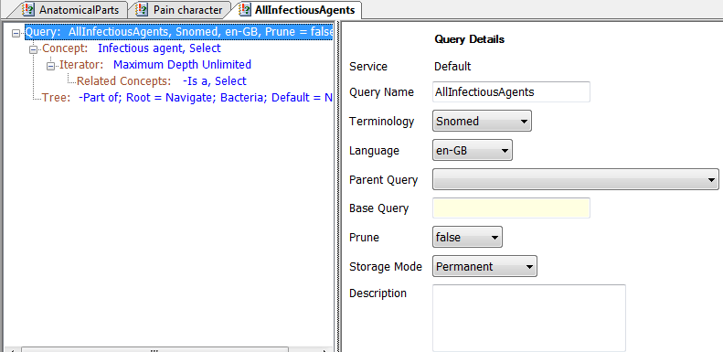
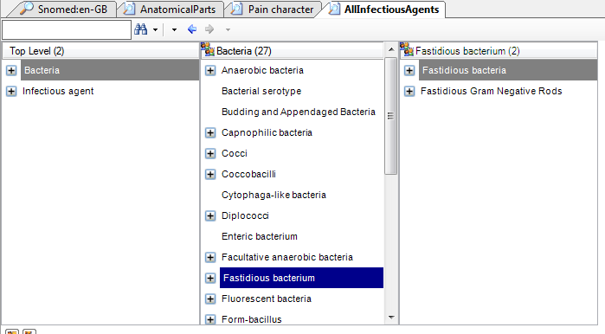
All Infectious Agents ref set
Definition
Result →

Slide 42
Future approaches

Slide 43
1 Compositional constraints
WHEN: we already agree on using single post-coordinated code phrase
E.g. Want to force information capture of site to include laterality, where it is defined.
Can express a SNOMED constraint for this that forces laterality to exist.
This capability does not yet exist in openEHR, but is very easy to add into the C_CODE_PHRASE constraint class
Requires a solid definition of SNOMED constraint grammar

Slide 44
2 Context-dependent bindings
WHEN: terminology codes incorporate contextual value, e.g. patient sex, pathology challenge, time, etc
E.g. Bindings to LOINC codes can depend on ‘protocol’, i.e. LOINC ‘challenge’
Some SNOMED concepts are specific to patient gender or other attributes

Slide 45
E.g. Lying systolic bp
The following not legal ADL today, but it could be....
/data/events[at0006|any event|]/data/items[Systolic] WHEN /data/events[at0006|any event|] /state /items[at0008|Position|] = at1003|Lying| ➔ 407556006|Lying systolic blood pressure|

Slide 46
2 Context-dependent bindings
Would need small syntax addition in ADL to connect a condition (FOPL expression on archetype data) to a concept in terminology.
Considerations for SNOMED:
Excessive precoordination makes concept selection difficult; query author might select another concept

Slide 47
3 Compositional pattern approach
WHEN: there are multiple attributes in IM (some may be post-coordinated), that we want to code together rather than separately
The emergence of patterns for Compositions of complex clinical statements may be useful in solving the binding problem
Beginning looks promising
Questions:
how will this work evolve?
HOW MUCH COMPOSITION IS ENOUGH?

Slide 48
Clinical finding present + site + side
Situation
Associated
finding
<finding>
Finding-site
<site>
Group
Laterality
<side>
Finding context
Known present
Temporal context
Current or specified time
Subject relationship context
Subject of record
Clinical-finding-present-with-site-and-side (<finding>,<site>,<side>)

Slide 49
Bleeding of left index finger present
Situation
Associated
finding
bleeding
index finger structure
Finding-site
Group
Laterality
left
Finding context
Known present
Temporal context
Current or specified time
Subject relationship context
Subject of record
Clinical-finding-present-with-site-and-side (bleeding, index finger structure, left)

Slide 50
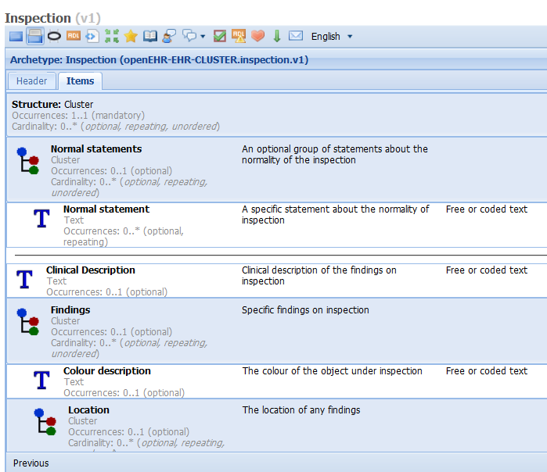
Inspection archetype

Slide 51
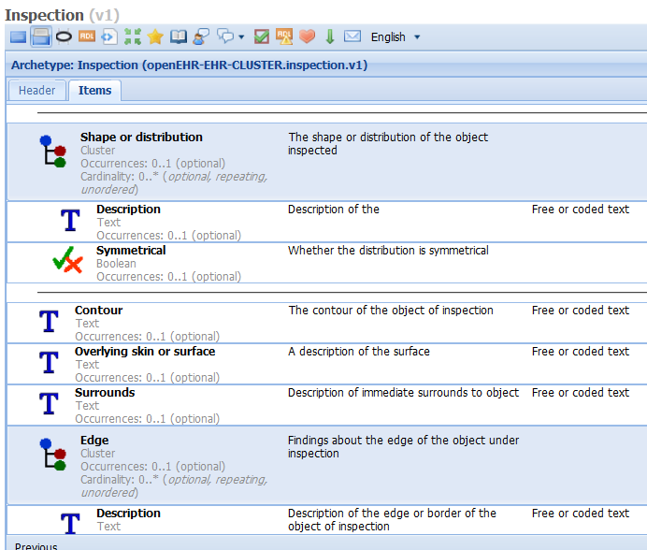

Slide 52
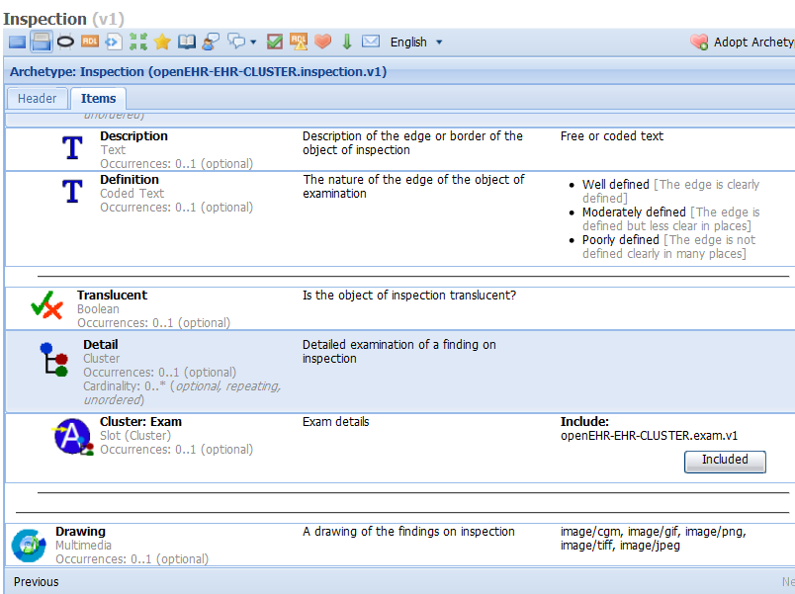

Slide 53
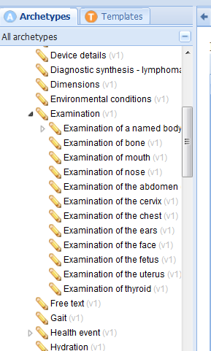

Slide 54
Binding ....
Archetype(s) are far more detailed (but mostly optional data points)
Two data points match:
/items[Clinical description] = Finding
/items[Findings]/items[Location]/items[Description] = Site
Mismatches:
Second is 0..* - e.g. a burn could be in multiple locations → pattern only allows 1 location
Archetype location assumes laterality included – needs variant pattern?

Slide 55
Possible general approach
Map pattern parameters to content model data points; add following to archetype:
Concept_bindings = <
[“SNOMEDCT”] = <
patterns = <
[“clinical finding”] = <
name = <[1213124|clinical finding present|]>
mappings = <
[02020202|finding|] = </items[at0004|Clinical description|]>
[33333222|site] = ..............................................</items[Findings]/items[Location]/items[Description] >
>
>
>
>

Slide 56
Potential?
Could this work generally?
Could avoid full Compositional code strings in data, and instead map pattern parameters to IM data points
➔ reduces dependence
But how stable are the parameters?
Will there be enough patterns?

Slide 57
Summary
openEHR archetype/template approach provides a semantic framework for capturing, representing and querying any data
BIG ADVANTAGE: bindings are expressde in archetypes and templates, NOT THE DATA; can be added AFTER initial deployment
Initial binding approaches are working, but are incomplete, and may be out of date, e.g. Internal value sets → Ref sets in the future?

Slide 58
Challenges
When to code .... and not
How to ensure binding assumption matches query authors (there will be many of the latter)
How to choose SCT concepts.... pre-coordination problem
Need for SCT post-coordination expression equivalence to work
Solution that handles ICDx, LOINC, local terminologies

Slide 59
Questions?
Resources
http://www.openEHR.org/knowledge - archetypes
Other – see e.g. D Markwell’s CFH report 2009
Acknowledgements:
Kent Spackman – pattern slides

