Slide 1
Practical tools and methods for clinical decision- and process-support Welcome, webminar starts at 16:15 CET! Questions are welcome in seminar thread in the https://discourse.openehr.org/ forum http://openehr.se/ leads to the Swedish section of that forum. Info about openEHR https://openehr.org/

Slide 2
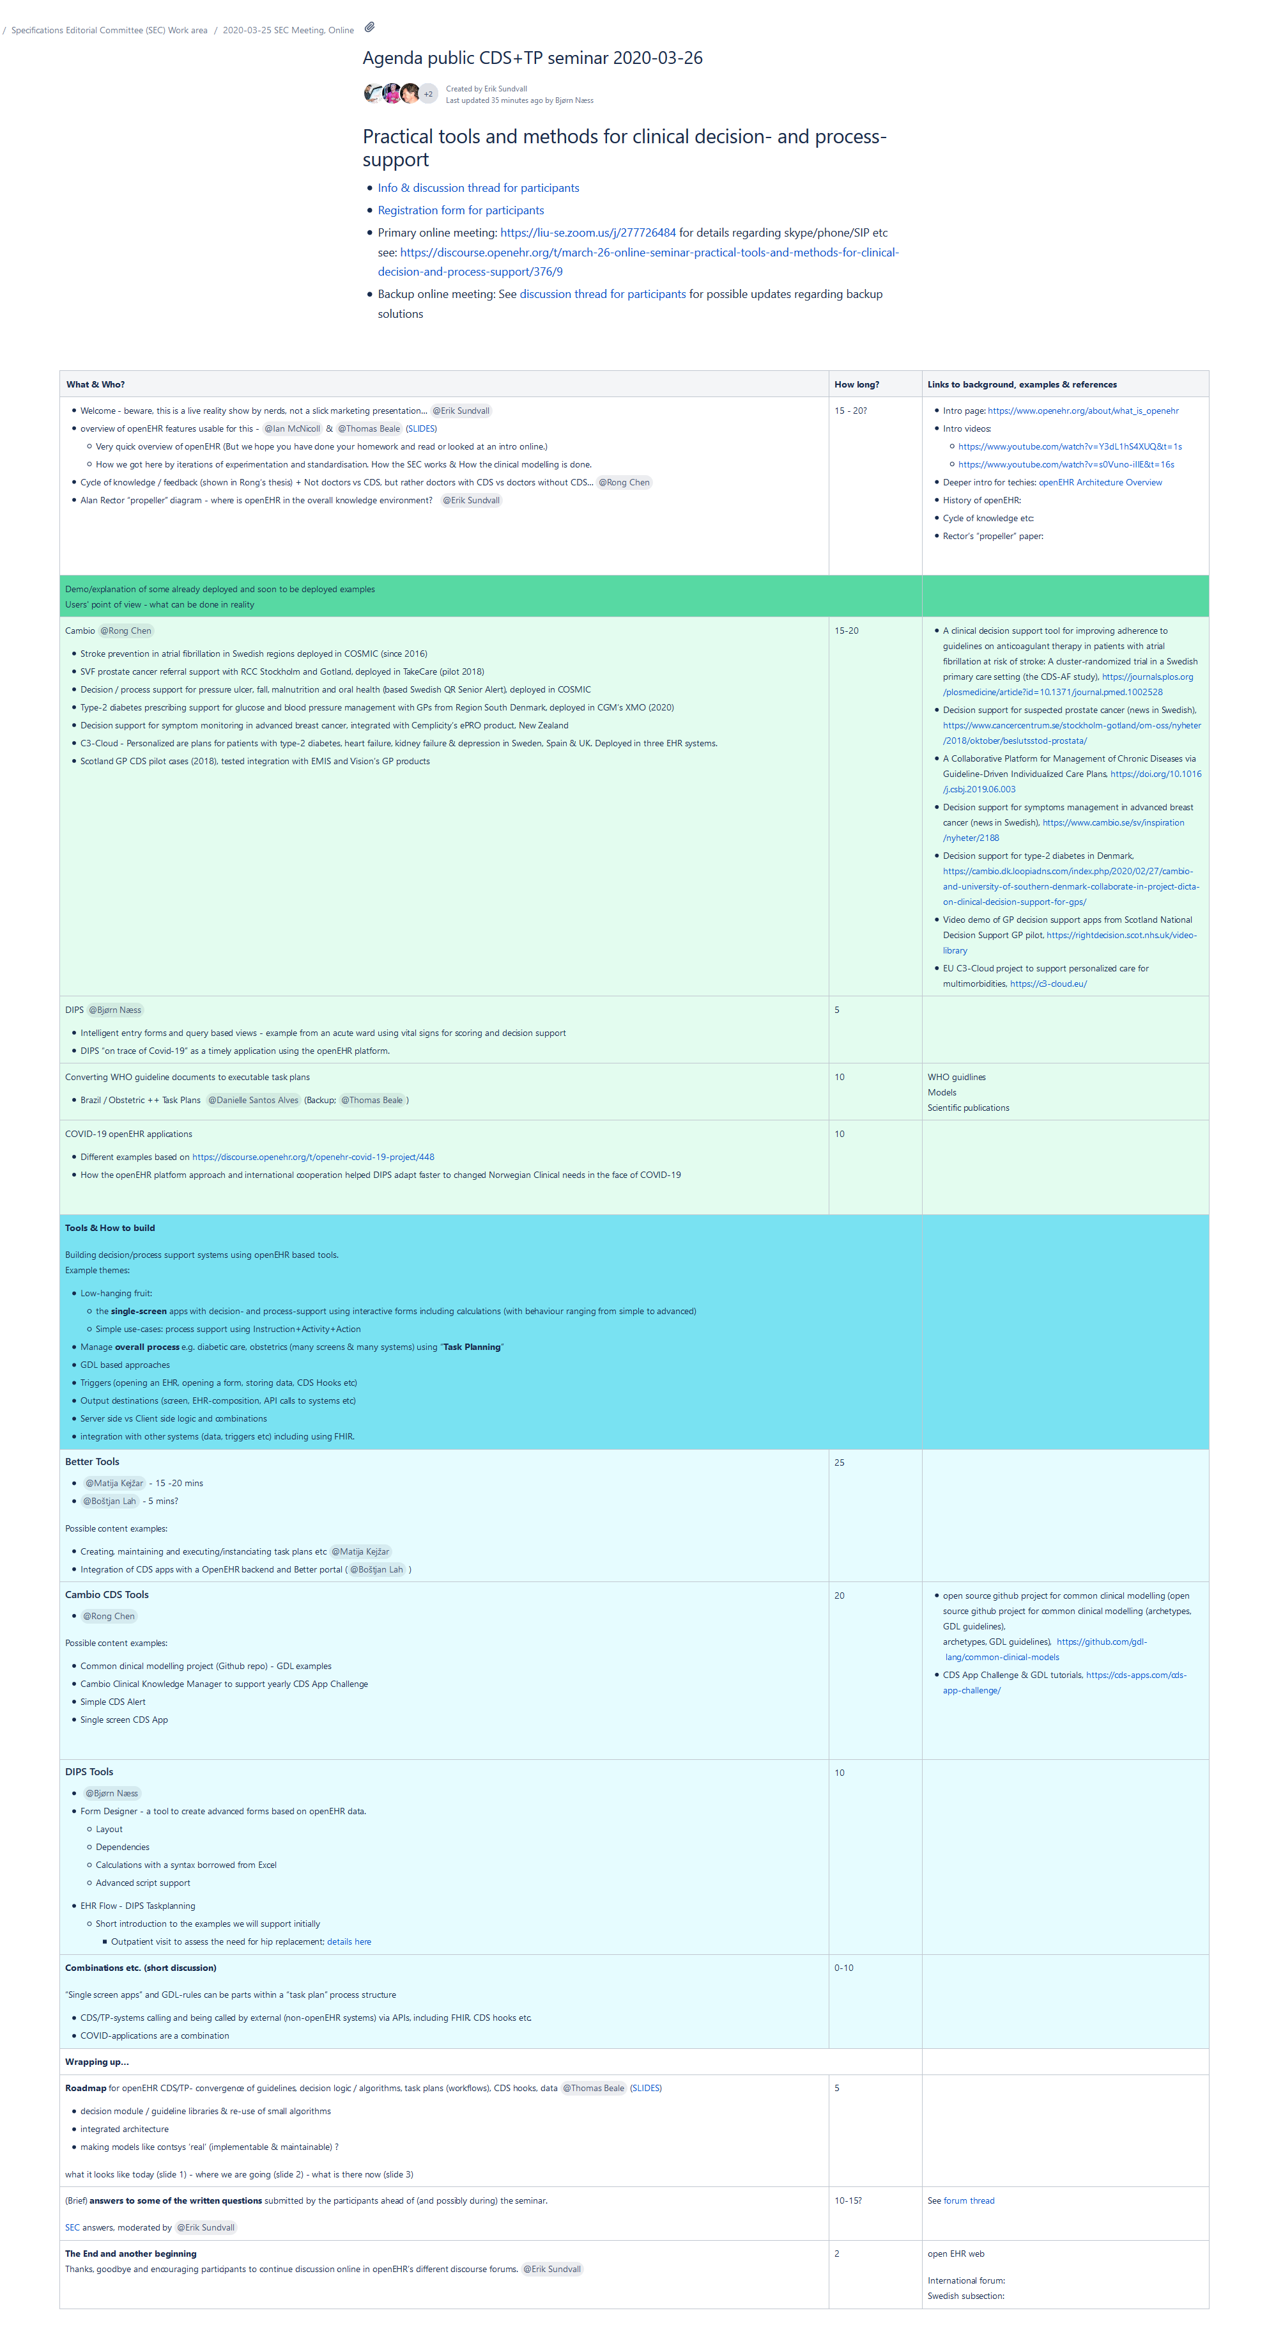
Agenda / programme
Contains presentations & references
16:15-18:18 CET
Intro
Real examples
Tools & How to build
Wrapping up & questions
Linked from the seminar info. Shortlink: https://openehr.atlassian.net/wiki/x/HgC_Ig

