Slide 1
Stockholm Seminar 26 Mar 2020: Practical tools and methods for
CDS and Process support in healthcare
openEHR Facilities
Thomas Beale
openEHR Management Board
Joint lead, openEHR Specification Program
Principal, Ars Semantica
Copyright 2019 openEHR Foundation

Slide 2
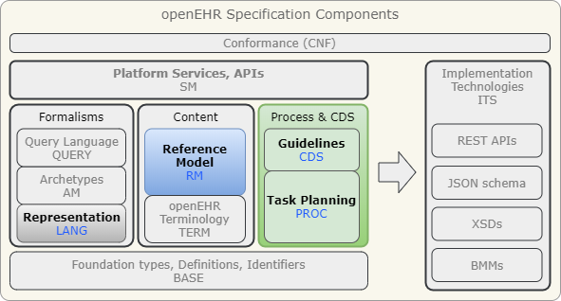
openEHR facilities for clinical process
Orders+Actions
GDL
Expression Lang,
meta-model
Task Planning

Slide 3
Main challenge
Making paper guidelines (PDF, HTML, …), order sets, care pathways
… computable
So they become part of the operational care delivery workplace for professionals
And also become ‘real’ for patients (via apps).

Slide 4
Scenarios
Basic prescribe & administer
→ std openEHR EHR model (Instruction, Action)
CDS to enable docs to use guidelines
→ GDL
Risk analysis over patient base using GL
→ GDL
Care pathways – tracking (e.g. diabetic patients), plan-based care (obstetric), administration (chemo), complex & team-based (ARDS, sepsis)
→ Task Planning

Slide 5
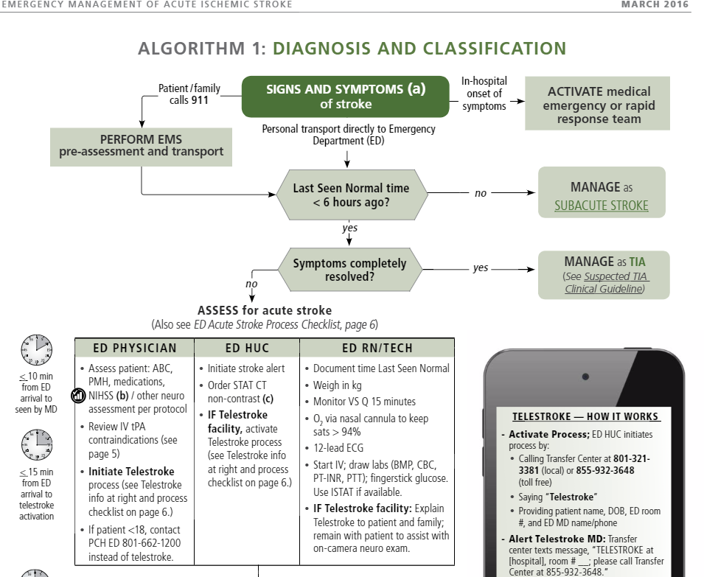
Part of a 20-page
guideline for acute
ischaemic stroke,
7 performers
(Intermountain HC)
Humans need help
to follow this
properly

Slide 6
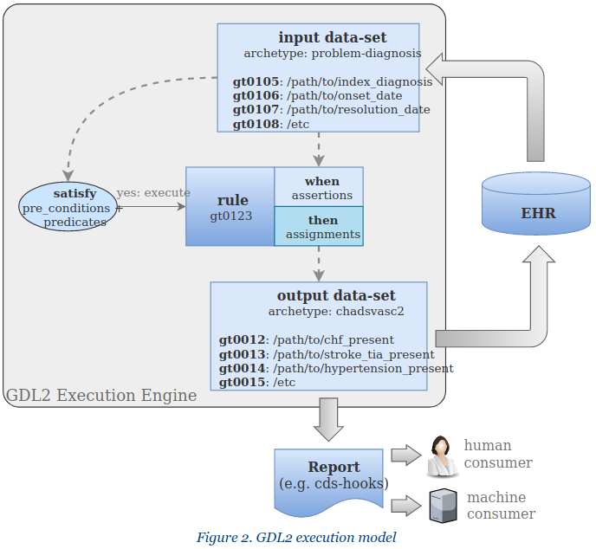
GDL

Slide 7
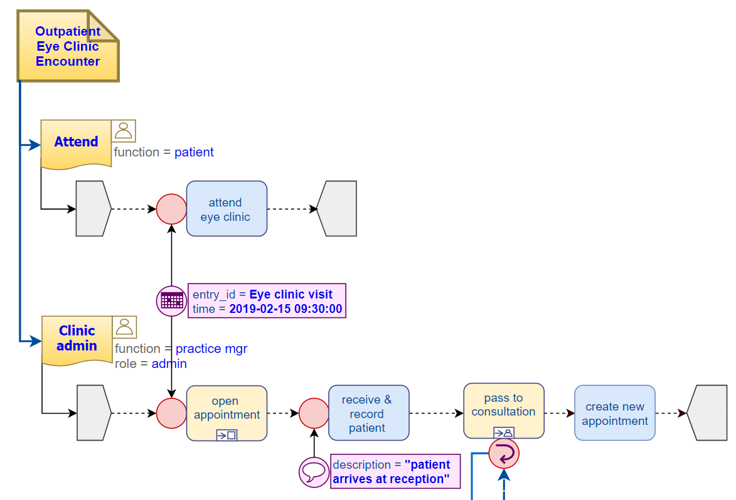
Task Planning
Example: outpatient eye clinic encounter (DIPS)

Slide 8
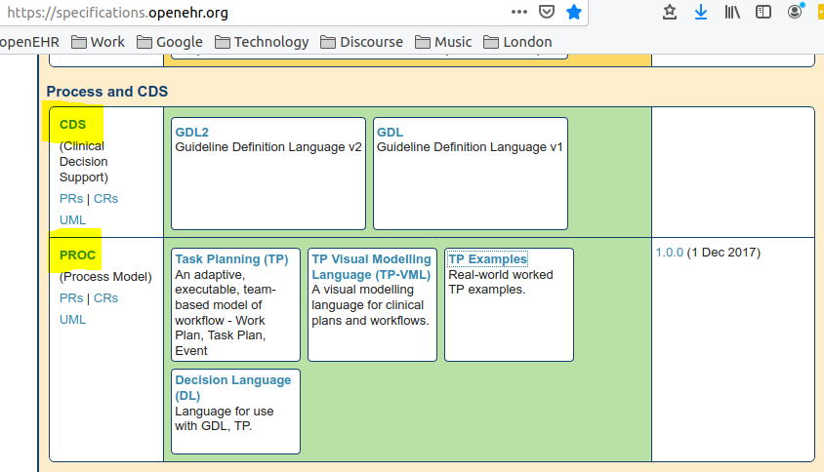
Resources

