Slide 1
Stockholm Seminar 26 Mar 2020: Practical tools and methods for
CDS and Process support in healthcare
openEHR Roadmap
Thomas Beale
openEHR Management Board
Joint lead, openEHR Specification Program
Principal, Ars Semantica
Copyright 2019 openEHR Foundation

Slide 2
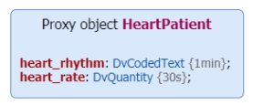
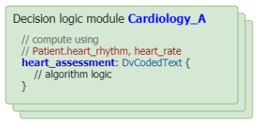
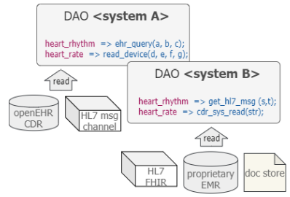
Task
Planning
(exceptions,
ad hoc,
Costing)
app
app
Integration points
app
Data
‘Proxy’
app
Concrete
data
Access
(AQL++)
app
Guidelines – GDL3
“GL Decision Language”

